Slide 1
Cascading Style Sheets
CSS

Slide 2
Cascading Style Sheets (CSS) is a style sheet language used for describing the look and formatting of a document written in a markup language. CSS3 is a latest standard of css.
The main difference between css2 and css3 is follows −
Media Queries
Namespaces
Selectors Level 3
Color
By using CSS, we separate the content of a web page from the presentation (format and styling) of that content.

Slide 3
What Does "Cascading" Mean?
We use the term "cascading" because there is an established order of priority to resolve formatting conflicts:
Inline style (highest priority)
Internal style sheet (second priority)
External style sheet (third priority)
Web browser default (only if not defined elsewhere)
For each XHTML element, the browser will see which styles are defined inline and from internal and external style sheets. For any conflicts detected, it will use this priority system to determine which format to display on the page.
If multiple, conflicting styles are defined in the same style sheet, only the final one will be applied.

Slide 4
Why Use CSS
Time Saving
Before CSS, tags like font, color, background style, element alignments, border and size had to be repeated on every web page. This was a very long process.
CSS style definitions are saved in external CSS files so it is possible to change the entire website by changing just one file.
Provide more attributes
CSS provides more detailed attributes than plain HTML to define the look and feel of the website.

Slide 5
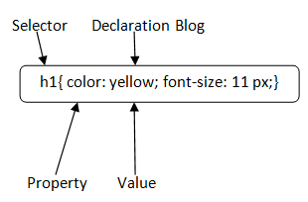
CSS Syntax
A CSS comprises of style rules that are interpreted by the browser and then applied to the corresponding elements in your document. A style rule is made of three parts
Selector − A selector is an HTML tag at which a style will be applied. This could be any tag like <h1> or <table> etc.
Property − A property is a type of attribute of HTML tag. Put simply, all the HTML attributes are converted into CSS properties. They could be color, border etc.
Value − Values are assigned to properties.

Slide 6
CSS selectors
CSS selectors are patterns used to select and style HTML elements on a web page.
Selectors are the part of CSS rule set and are a fundamental part of Cascading Style Sheets (CSS).
There are several different types of selectors in CSS.
CSS Element Selector
CSS Id Selector
CSS Class Selector
CSS Universal Selector
CSS Group Selector

Slide 7
CSS Element Selector
The element selector selects the HTML element by name.
P {
text-align: center;
color: blue;
}
h1 {
text-decoration-line: underline;
}

Slide 8
CSS Id Selector
The id selector selects the id attribute of an HTML element to select a specific element. An id is always unique within the page so it is chosen to select a single, unique element.
It is written with the hash character (#), followed by the id of the element.
#style1 {
text-align: center;
color: blue;
}
<p id=“style1">Hello Class</p>

Slide 9
CSS Class Selector
The class selector selects HTML elements with a specific class attribute. It is used with a period character . (dot) followed by the class name.
.style1 {
text-align: center;
color: blue;
}
<p class=“style1">Hello Class</p>
Class Name should not start with number.

Slide 10
CSS Class Selector for specific element
If you want to specify that only one specific HTML element should be affected then you should use the element name with class selector.
p.center {
text-align: center;
color: blue;
}
<h1 class="center">This heading is not affected</h1>
<p class="center">This paragraph is blue and center-aligned.</p>
<p> hi class </p>

Slide 11
CSS Universal Selector
The universal selector is used as a wildcard character. It selects all the elements on the pages.
* {
color: green;
font-size: 20px;
}

Slide 12
CSS Group Selector
The grouping selector is used to select all the elements with the same style definitions.
h1 {
text-align: center;
color: blue;
}
h2 {
text-align: center;
color: blue;
}
p {
text-align: center;
color: blue;
}
h1,h2,p {
text-align: center;
color: blue;
}

Slide 13
Types of CSS
CSS is added to HTML pages to format the document according to information in the style sheet. There are three ways to insert CSS in HTML documents.
Inline CSS
Internal CSS
External CSS
Advantage
Separate style from content
Content (what to display) is in HTML files
Formatting information (how to display it) is in separate style sheets (.css files).

Slide 14
External Style Sheet
An external style sheet is a separate file where you can declare all the styles that you want to use on your website. You then link to the external style sheet from all your HTML pages.
This means you only need to set the styles for each element once. If you want to update the style of your website, you only need to do it in one place.
Create the Style Sheet
Type CSS code into a plain text file, and save with a .css extension.
Add a link tag in between the head tag to link the style sheet with the page.

Slide 15
<LINK REL=StyleSheet HREF="style.css" TYPE="text/css" MEDIA=screen>
TYPE attribute is used to specify a media type--text/css for a Cascading Style Sheet--allowing browsers to ignore style sheet types that they do not support.
The REL attribute is used to define the relationship between the linked file and the HTML document.
Href specifies the style sheet file having Style rules. This attribute is a required.
Media specifies the device the document will be displayed on. Default value is all. This is optional attribute.

Slide 16
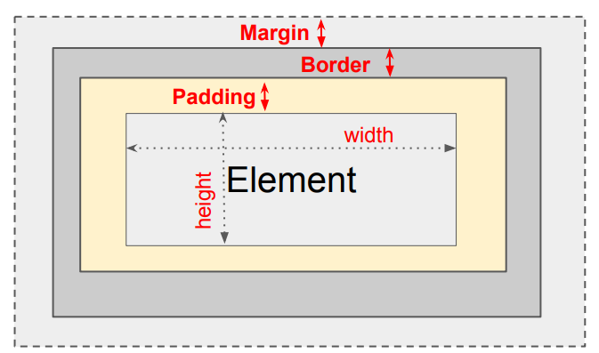
CSS Box Model
The “CSS box model” is a set of rules that determine the dimensions of every
element in a web page.
It is a box that wraps around every HTML element. It consists of: content, padding, borders and margins.

Slide 17
Content - The content of the box, where text and images appear
Padding - The space between the box’s content and its border.
Border - A border that goes around the padding and content.
Margin - The space between the box and surrounding boxes.
Total element width = width + left padding + right padding + left border + right border + left margin + right margin
div {
width: 300px;
height: 50px;
padding: 10px;
border: 5px solid gray;
margin: 0;
}
300px (width of content area) + 20px (left padding + right padding) + 10px (left border + right border)
= 330px (total width)
50px (height of content area) + 20px (top padding + bottom padding) + 10px (top border + bottom border)
= 80px (total height)

Slide 18
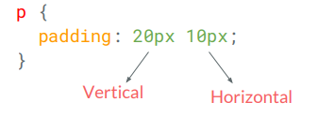
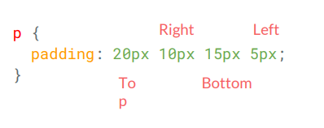
Some CSS Properties
Padding
p {
padding-top: 20px;
padding-bottom: 20px;
padding-left: 10px;
padding-right: 10px;
}

Slide 19
Borders
Border is a line drawn around the content and padding of an element.
Borders are specified as "thickness, style, color"
h1 {
border: 1px solid red;
}
h1 {
border: 4px dotted green;
}
h1 {
border-top: 1px solid red;
border-right: 2px dotted green; border-bottom: 3px dashed yellow; border-left: 4px double purple;
}

Slide 20
position property
position: static; (default) - Position in document flow
position: relative; Position relative to default position via top, right, bottom, and left properties
position: fixed; Position to a fixed location on the screen via top, right, bottom, and left properties
position: absolute; Position relative to ancestor absolute element via top, right, bottom, and left properties
Fixed position (0,0) is top left corner

Slide 21
<html>
<body>
<div class="parent">
<div class="style1">
Element 1.
</div>
<div class="main">
Element 2.
</div>
<div class="style1">
Element 3.
</div>
</div>
</body>
<html>
Static
This is the default value for elements. The element is positioned according to the normal flow of the document. The left, right, top, bottom and z-index properties do not affect an element with position: static.

Slide 22
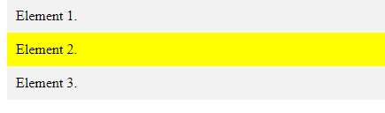
.main {
position: static;
left: 10px;
bottom: 10px;
background-color: yellow;
padding: 10px;
}
.style1 {
padding: 10px;
background-color: #f2f2f2;
}

Slide 23
Relative
Elements with position: relative remain in the normal flow of the document. But, unlike static elements, the left, right, top, bottom and z-index properties affect the position of the element.
.main {
position: relative;
left: 10px;
bottom: 10px;
background-color: yellow;
padding: 10px;
}
.style1 {
padding: 10px;
background-color: #f2f2f2;
}

Slide 24
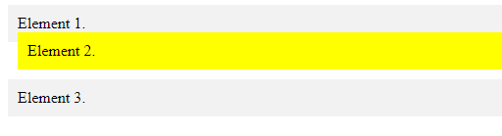

Slide 25
Absolute
Elements with position: absolute are positioned relative to their parent elements. In this case, the element is removed from the normal document flow.
The other elements will behave as if that element is not in the document. No space is created for the element in the page layout.
The values of left, top, bottom and right determine the final position of the element.
One thing to note is that an element with position: absolute is positioned relative to its closest positioned ancestor. That means that the parent element has to have a position value other than position: static.
If the closest parent element is not positioned, it is positioned relative to the next parent element that is positioned. If there's no positioned ancestor element, it is positioned relative to the <html> element.

Slide 26
<html>
<body>
<div class="parent">
<div class="style1">
Element 1.
</div>
<div class="main">
Element 2.
</div>
<div class="style1">
Element 3.
</div>
</div>
</body>
<html>
.main {
position: absolute;
left: 10px;
bottom: 10px;
background-color: yellow;
padding: 10px;
}
.parent {
position: relative;
height: 100px;
padding: 10px;
background-color: #81adc8;
}
.style1 {
background: #f2f2f2;
padding: 10px;
}

Slide 27
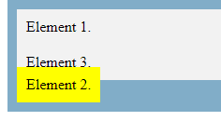

Slide 28
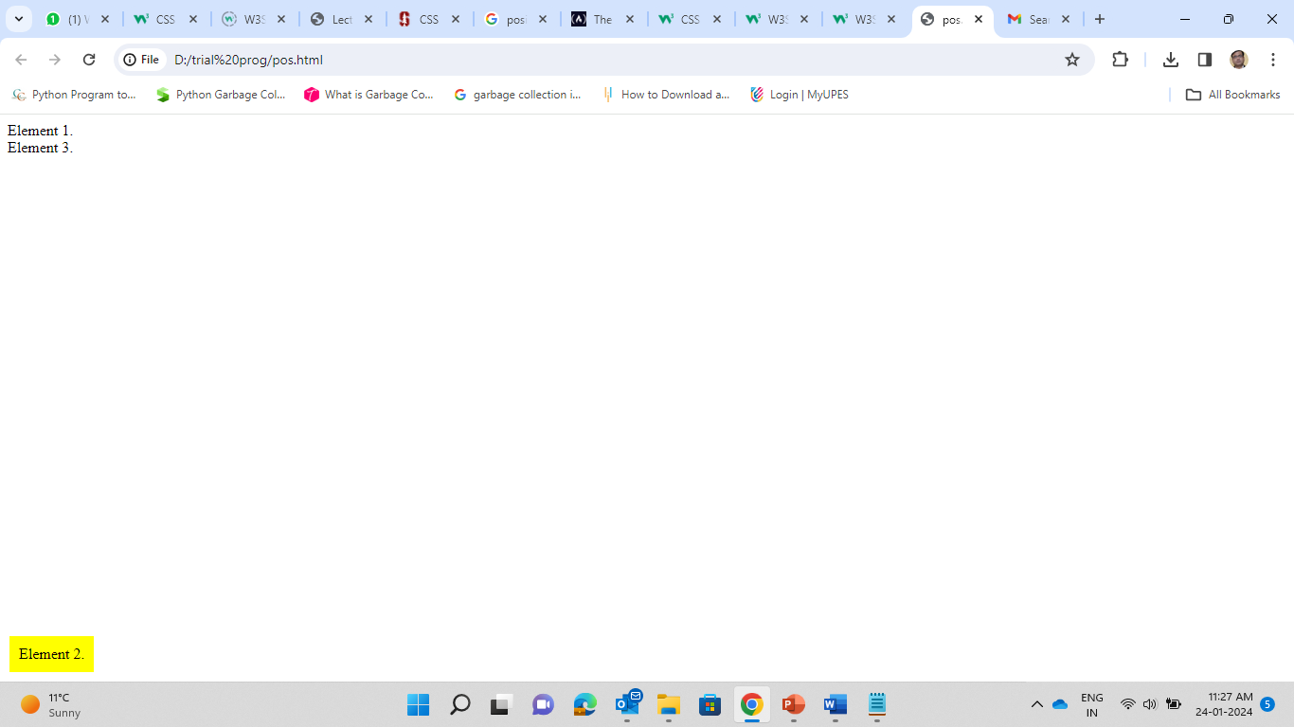
Fixed
Fixed position elements are similar to absolutely positioned elements. They are also removed from the normal flow of the document. But unlike absolutely positioned element, they are always positioned relative to the <html> element.
.main {
position: fixed;
bottom: 10px;
left: 10px;
background-color: yellow;
padding: 10px;
}
html {
height: 500px;
}

Slide 29
Sticky
position: sticky is a mix of position: relative and position: fixed. It acts like a relatively positioned element until a certain scroll point and then it acts like a fixed element.
.main {
position: sticky;
top: 10px;
background-color: yellow;
padding: 10px;
}
.parent {
position: relative;
height: 800px;
padding: 50px 10px;
background-color: #81adc8;
}

Slide 30
background-image: image for element's background
background-repeat: should background image be displayed in a repeating pattern (versus once only)
Font
font, font-family, font-size, font-weight, font-style
Text
text-align, vertical-align: Alignment: center, left, right

Slide 31
CSS transform property
“The CSS transform property lets you modify the coordinate space of the CSS visual formatting model. Using it, elements can be translated, rotated, scaled, and skewed according to the values set.
Transform Functions
Rotate
Scale
Skew
Translate

Slide 32
Rotate
Rotates an element clockwise from its current position. Counter clockwise rotations can be achieved by using negative values.
Syntax
transform: rotate(angle);

Slide 33
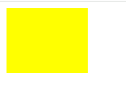

<html>
<head>
<style>
div{
width:100px;
height:80px;
background-color:yellow;
transform: rotate(45deg);
}
</style>
</head>
<body>
<div>
</div>
</body>
</html>
Before Applying Transformation
After Applying Transformation

Slide 34
Scale
Scales an element relative to its original size. The values specified within scale transforms are unitless and should be thought of as a multiplier.
transform: scale(valueX, valueY);
transform: scaleX(valueX);
transform: scaleY(valueY);
To scale an element uniformly along the X- and Y-axis in CSS
div{
width:100px;
height:80px;
background-color:yellow;
transform: scale(0.5);
}

Slide 35
Translation
Translation allows us to move an item around. We can use translate to shift an item along in either axis: x moves side to side, y moves up and down. Positive values move down and to the right. Negative values move up and to the left.
<html>
<head>
<style>
div{
width:100px;
height:80px;
background-color:yellow;
transform: translate(60px,100px);
}
</style> </head>
<body>
<div>
</div>
</body> </html>

Slide 36
Skew
Skews an element along the X and/or Y axis by an angle value.
Syntax
transform: skewX(angleX);

Slide 37
To apply more than one transformations
div{
width:100px;
height:80px;
background-color:yellow;
transform: translate(60px,100px) rotate(45deg);
}

Slide 38
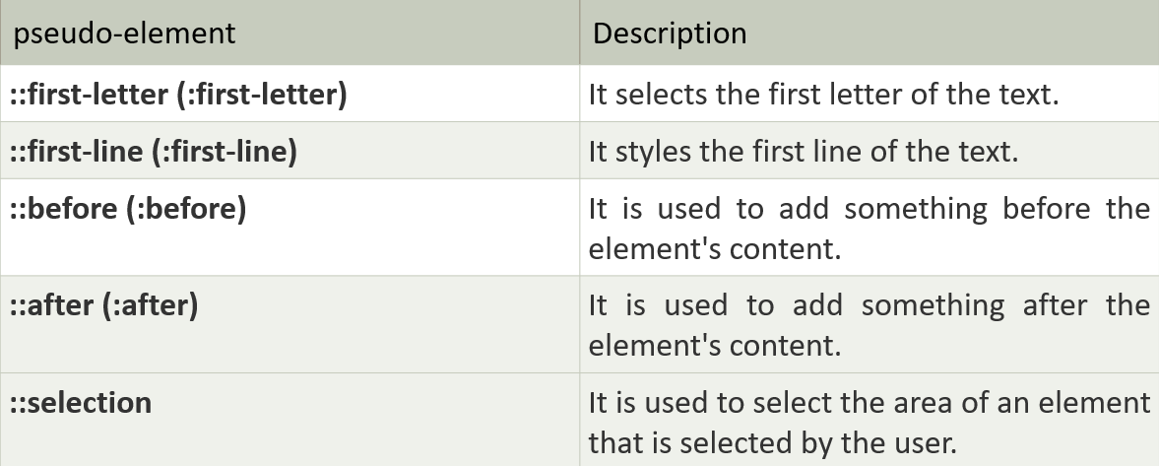
Pseudo-Elements
A pseudo-class can be defined as a keyword which is combined to a selector that defines the special state of the selected elements. Unlike the pseudo-classes, the pseudo-elements are used to style the specific part of an element, whereas the pseudo-classes are used to style the element.
Syntax
selector::pseudo-element {
property: value;
}

Slide 39
<html>
<head>
<style>
body{ text-align: center; }
h1::first-letter {
font-family: Lucida Calligraphy;
font-size: 3cm;
color: red;
text-shadow: 5px 8px 9px green;
}
h1{
color: blue;
}
</style>
</head>
<body>
<h1> Welcome Everyone </h1>
</body>
</html>

Slide 40
<!DOCTYPE html>
<html>
<head>
<style>
p::first-line {
color: #ff0000;
font-size:20px;
}
</style>
</head>
<body>
<p>Welcome to Web Technologies Class. The last date for submitting the Project in lieu of Assignment is 15th April 2024. After that no marks will be allocated. The Project will be of 40 marks.</p>
</body>
</html>

Slide 41
<html>
<head>
<style>
body{
text-align: center;
}
h1::before {
content: "Hello World. ";
color: #ff33f3;
}
</style>
</head>
<body>
<h1>Welcome Class </h1>
</body>
</html>

Slide 42
<html>
<head>
<style>
body{
text-align: center;
}
h1::selection {
color: #ff33f3;
}
</style>
</head>
<body>
<h1> B.Tech CSE IV AI-ML Batch </h1>
</body>
</html>

Slide 43
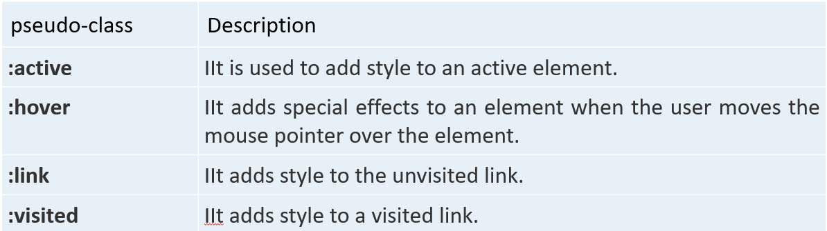
CSS pseudo-classes
A pseudo-class can be defined as a keyword which is combined to a selector that defines the special state of the selected elements. It is added to the selector for adding an effect to the existing elements based on their states.
Syntax
selector: pseudo-class
{
property: value;
}

Slide 44
<html>
<head>
<style>
body{
text-align:center;
}
P:hover{
color:#ff33f3;
}
h2:hover{
color:blue;
}
</style>
</head>
<body>
<P>B.Tech CSE </P>
<h2>Web Technologies</h2>
</body>
</html>

Slide 45
<!DOCTYPE html>
<html>
<head>
<style>
a:link { color: red; }
a:visited { color: green; }
a:hover { color: hotpink; }
a:active { color: blue; }
</style>
</head>
<body>
<b><a href=" " target="_blank">Hello</a></b>
</body>
</html>

Slide 46
CSS Transitions
A transition describes how a property should display change when given a different value.
The transition property allow elements to change values over a specified duration, animating the property changes, rather than having them occur immediately.
Transition Properties
transition-property
transition-duration
transition-timing-function
transition-delay
Shorthand
transition: property duration timing-function delay;
Longhand
transition-property: property;
transition-duration: duration;
transition-timing-function: timing-function;
transition-delay: delay;

Slide 47
<html>
<head>
<style>
div {
width: 100px;
height: 100px;
background: red;
transition: width 2s;
}
div:hover {
width: 300px;
}
</style>
</head>
<body>
<div></div>
</body>
</html>

Slide 48
<html>
<head>
<style>
div {
width: 100px;
height: 100px;
background: red;
transition: width 2s, height 2s, transform 2s;
}
div:hover {
width: 300px;
height: 300px;
transform: rotate(180deg);
}
</style>
</head>
<body>
<div></div>
</body>
</html>

Slide 49
Transition-timing-function
Specifies the speed curve of the transition effect. Meaning, the type of speed variation you want to select for your transition effect.
ease - specifies a transition effect with a slow start, then fast, then end slowly (default)
linear - specifies a transition effect with the same speed from start to end
ease-in - specifies a transition effect with a slow start
ease-out - specifies a transition effect with a slow end
ease-in-out - specifies a transition effect with a slow start and end

Slide 50
<html>
<head>
<style>
div {
background: #2db34a;
height: 95px;
transition-property: background;
transition-duration: 3s;
transition-timing-function: linear;
width: 95px;
}
div:hover{
background: #ff7b29;
}
</style>
</head>
<body>
<div>
</div>
</body>
</html>

Slide 51
<html>
<head>
<style>
div{
background: #2db34a;
border-radius: 5px;
height: 250px;
transition-property: border-radius;
transition-duration: 2s;
transition-timing-function: linear;
width: 150px;
}
div:hover {
border-radius: 50%;
background: #000099;
}
</style>
</head>
<body>
<div>
</div>
</body>
</html>

Slide 52
CSS Animations
CSS Animations are an excellent way to create visual animations that are not restricted to a single motion like CSS Transitions but are far more developed.
As web development technology has evolved, CSS Animations has become more popular and provides greater control and flexibility over the animation effects.
CSS animations are made up of two basic building blocks.
Keyframes - define the stages and styles of the animation.
Animation Properties - assign the @keyframes to a specific CSS element and define how it is animated.

Slide 53
Keyframes
Keyframes are the foundation of CSS animations. They define what the animation looks like at each stage of the animation timeline.
Keyframes define the start and end points of an animation and specify the styles that the element should have at different points during the animation.
Keyframes are defined using the @keyframes rule and are applied to elements using the animation property.
Each @keyframes is composed of:
Name of the animation: A name that describes the animation.
Stages of the animation: Each stage of the animation is represented as a percentage. 0% represents the beginning state of the animation. 100% represents the ending state of the animation. Multiple intermediate states can be added in between.
CSS Properties: The CSS properties defined for each stage of the animation timeline.

Slide 54
<html>
<head>
<style>
.box {
width: 100px;
height: 100px;
background: lightblue;
border: solid 2px;
animation-name: moveObject;
animation-duration: 2s;
animation-timing-function: linear;
}
@keyframes moveObject {
from {
transform: translateX(0);
background-color: red;
}
50% {
transform: translateX(300px);
}
to {
transform: translateX(300px) scale(1.5);
background-color: yellow;
}
}
</style>
</head>
<body>
<div class="box">
</div>
</body>
</html>

Slide 55
<html>
<head>
<style>
div {
width: 100px;
height: 100px;
background-color: red;
position: relative;
animation-name: example;
animation-duration: 4s;
animation-iteration-count: infinite;
}
@keyframes example {
0% {background-color:red; left:0px; top:0px;}
25% {background-color:yellow; left:200px; top:0px;}
50% {background-color:blue; left:200px; top:200px;}
75% {background-color:green; left:0px; top:200px;}
100% {background-color:red; left:0px; top:0px;}
}
</style>
</head>
<body>
<div></div>
</body>
</html>

Slide 56
Responsive web design
Responsive web design is about creating web pages that look good on all devices. A responsive web design will automatically adjust for different screen sizes and viewports.
Responsive Web Design (RWD) is a Web design approach aimed at crafting sites to provide an optimal viewing experience, easy reading and navigation with a minimum of resizing, panning, and scrolling, across a wide range of screen sizes and devices.
Responsive web design principles
– Fluid-grid
– Fluid image/media
– Media query

Slide 57
Fluid Layout
• Fluid layout, is the practice of building the layout of a website capable of dynamically
resizing to any width.
– using relative length units, most commonly percentages or em units.
– Set the width using %
– Set margin and padding using %
Adaptive Image
• Apply similar fluid practices to images using percentages.
The image can be scaled up to be larger than its original size, which makes the image blurry. A better solution, in many cases, will be to use the max-width property.
img
{
display: block;
max-width: 100%;
}

Slide 58
Media Query
• Media query is a CSS3 module allowing content rendering to adapt to conditions such as screen resolution.
Media queries are based on rules (contexts) when a set of CSS should be applied.
@media screen and (max-width: 300px)
{
div {background-color: lightblue;}
}
<link rel="stylesheet" type="text/css" href=“a.css“ media="screen and (max-width: 300px)" />

Slide 59
When the width is between 400px and 600px on screen
@media screen and (max-width: 600px) and (min-width: 400px)
When the screen is in portrait orientation and width is less than 640px
@media screen and (max-width: 640px) and (orientation: portrait)

Slide 60
To create a responsive website, add the following <meta> tag to all your web pages:
<meta name="viewport" content="width=device-width, initial-scale=1.0">
This will set the viewport of your page, which will give the browser instructions on how to control the page's dimensions and scaling.

Slide 61
<html>
<head>
<meta name="viewport" content="width=device-width, initial-scale=1.0">
</head>
<body>
<picture>
<source srcset=“pic1.jpg" media="(max-width: 600px)">
<source srcset=“pic2.jpg" media="(max-width: 1100px)">
<source srcset=“pic3.jpg">
<img src=“pic2.jpg" alt=“pic" style="width:auto;">
</picture>
</body>
</html>

Slide 62
<!DOCTYPE html>
<html>
<head>
<style>
body {
background-color: tan;
color: black;
}
/* On screens that are 992px wide or less, the background color is blue */
@media screen and (max-width: 992px) {
body {
background-color: blue;
color: white;
}
}
/* On screens that are 600px wide or less, the background color is olive */
@media screen and (max-width: 600px) {
body {
background-color: olive;
color: white;
}
}
</style>
</head>
<body>
</body>
</html>

